Slide 1
Lab4 Questions
Yao Zhao

Slide 2
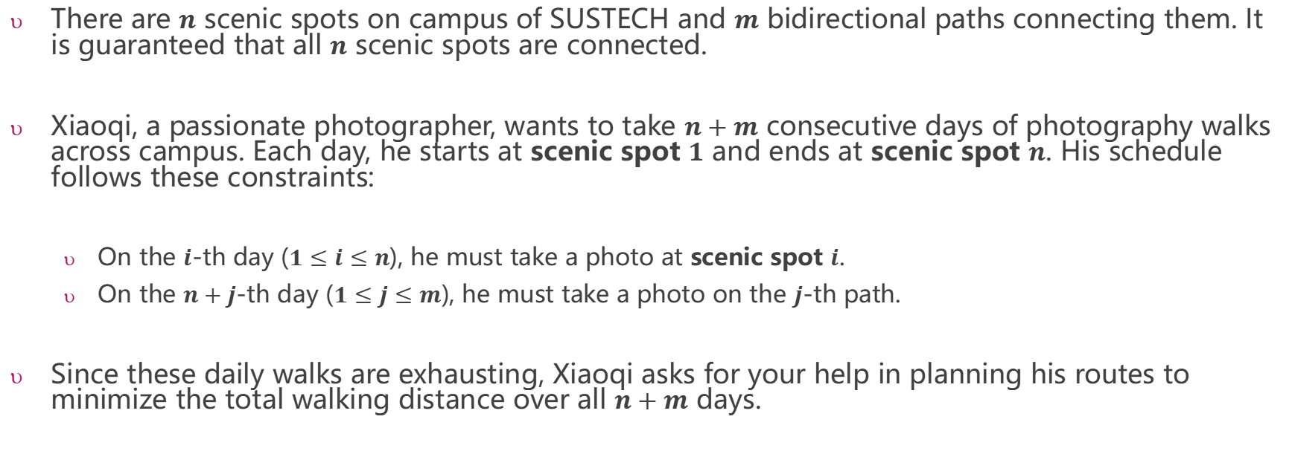
Lab4.A: Optimized Photography Route in Campus
There are $n$ scenic spots on campus of SUSTECH and $m$ bidirectional paths connecting them. It is guaranteed that all $n$ scenic spots are connected.
Xiaoqi, a passionate photographer, wants to take $n+m$ consecutive days of photography walks across campus. Each day, he starts at scenic spot $1$ and ends at scenic spot $n$. His schedule follows these constraints:
On the $i$-th day ($1≤i≤n$), he must take a photo at scenic spot $i$.
On the $n+j$-th day ($1≤j≤m$), he must take a photo on the $j$-th path.
Since these daily walks are exhausting, Xiaoqi asks for your help in planning his routes to minimize the total walking distance over all $n+m$ days.

Slide 3
Sample Input
6 8
1 2 3
2 3 4
1 4 5
2 5 8
5 6 2
3 5 7
3 6 1
4 5 6
3
4
1
2
3
5
8
1
7
Sample Output
8
8
8
13
12
8
8
8
13
13
12
16
8
13
6
2
4
5
6

Slide 4
Day 1: 1---->6, must visit 1
3
4
1
2
3
5
8
1
Distance: 8
7
6
2
4
5
6
Day 2: 1---->6, must visit 2
3
4
1
2
3
5
8
1
Distance: 8
7
6
2
4
5
6

Slide 5
Day 3: 1---->6, must visit 3
3
4
1
2
3
5
8
1
Distance: 8
7
6
2
4
5
6
Day 4: 1---->6, must visit 4
3
4
1
2
3
5
8
1
Distance: 13
7
6
2
4
5
6

Slide 6
Day 5: 1---->6, must visit 5
3
4
1
2
3
5
8
1
Distance: 12
7
6
2
4
5
6
Day 6: 1---->6, must visit 6
3
4
1
2
3
5
8
1
Distance: 8
7
6
2
4
5
6

Slide 7
Day 7: 1---->6, must visit the path (1 2)
3
4
1
2
3
5
8
1
Distance: 8
7
6
2
4
5
6
Day 8: 1---->6, must visit the path (2 3)
3
4
1
2
3
5
8
1
Distance: 8
7
6
2
4
5
6

Slide 8
Day 9: 1---->6, must visit the path (1 4)
3
4
1
2
3
Distance: 13
5
8
1
7
6
2
4
5
6
Day 10: 1---->6, must visit the path (2 5)
3
4
1
2
3
5
8
1
Distance: 13
7
6
2
4
5
6

Slide 9
Day 11: 1---->6, must visit the path (5 6)
3
4
1
2
3
5
8
Distance: 12
7
1
6
2
4
5
6
Day 12: 1---->6, must visit the path (3 5)
3
4
1
2
3
5
8
1
Distance: 16
7
6
2
4
5
6

Slide 10
Day 13: 1---->6, must visit the path (3 6)
3
4
1
2
3
5
8
1
Distance: 8
7
6
2
4
5
6
Day 14: 1---->6, must visit the path (4 5)
3
4
1
2
3
5
8
1
Distance: 13
7
6
2
4
5
6

Slide 11
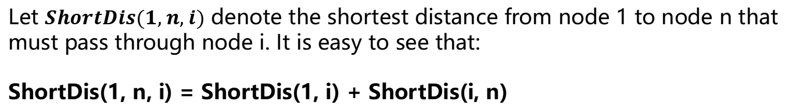
Lab4.A: Solution
Day 5: 1---->6, must visit 5
3
4
1
2
3
5
8
1
Distance: 12
7
6
2
4
5
6
Let $ShortDis(1, n, i)$ denote the shortest distance from node 1 to node n that must pass through node i. It is easy to see that:
ShortDis(1, n, i) = ShortDis(1, i) + ShortDis(i, n)

Slide 12
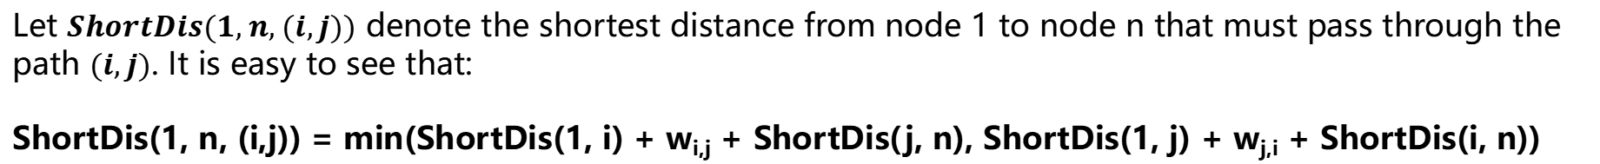
Lab4.A: Solution
Should node 1 go to node 5 first, or node 6 first?
ShortDis(1, 5)+w_{5,6}+ShortDis(6, 6)
=11+2+0 = 13
ShortDis(1, 6)+w_{6,5}+ShortDis(5, 6)
=8+2+2 = 12
Day 11: 1---->6, must visit the path (5 6)
3
4
1
2
3
5
8
1
7
min(13,12) = 12
6
2
4
5
6
Distance: 12
Let $ShortDis(1, n, (i,j))$ denote the shortest distance from node 1 to node n that must pass through the path $(i,j)$. It is easy to see that:
ShortDis(1, n, (i,j)) = min(ShortDis(1, i) + w_{i,j} + ShortDis(j, n), ShortDis(1, j) + w_{j,i} + ShortDis(i, n))

Slide 13
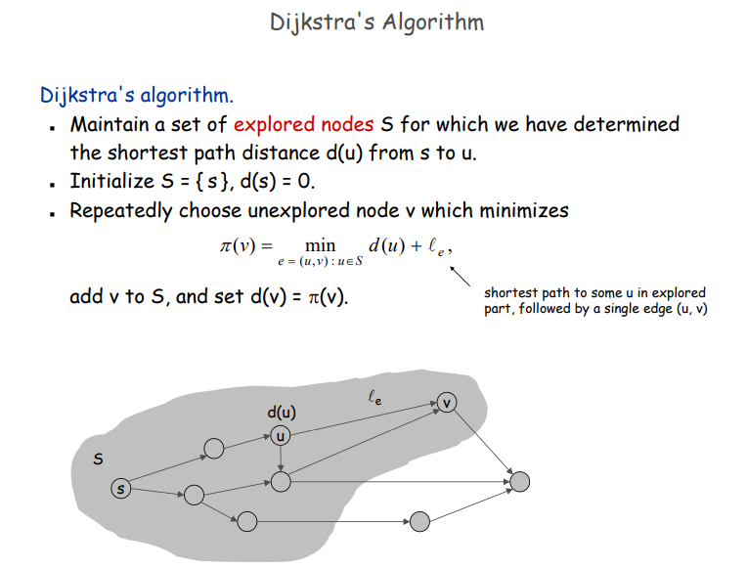
Lab4.A: Review Dijkstra’s Algorithm

Slide 14
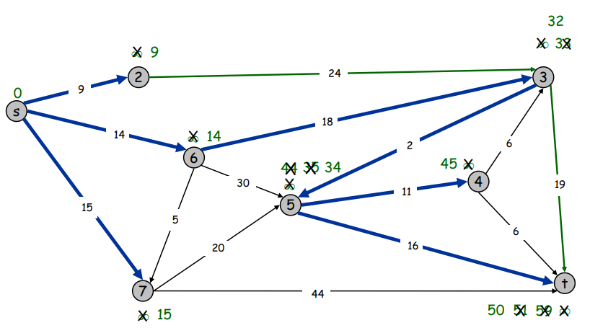
Lab4.A: Review Dijkstra’s Algorithm
In Dijkstra's algorithm, during the process of finding the shortest distance from node s to node t, if the graph is connected, we can obtain the shortest distances from s to all other nodes in the graph.
https://bb.sustech.edu.cn/bbcswebdav/pid-521068-dt-content-rid-17344656_1/courses/CS208-30001105-2025SP_2024-2025-2-CS208-001/04%20demo-dijkstra.pdf
Node | Distance
s | 0
2 | 9
3 | 32
4 | 45
5 | 34
6 | 14
7 | 15
t | 50

Slide 15
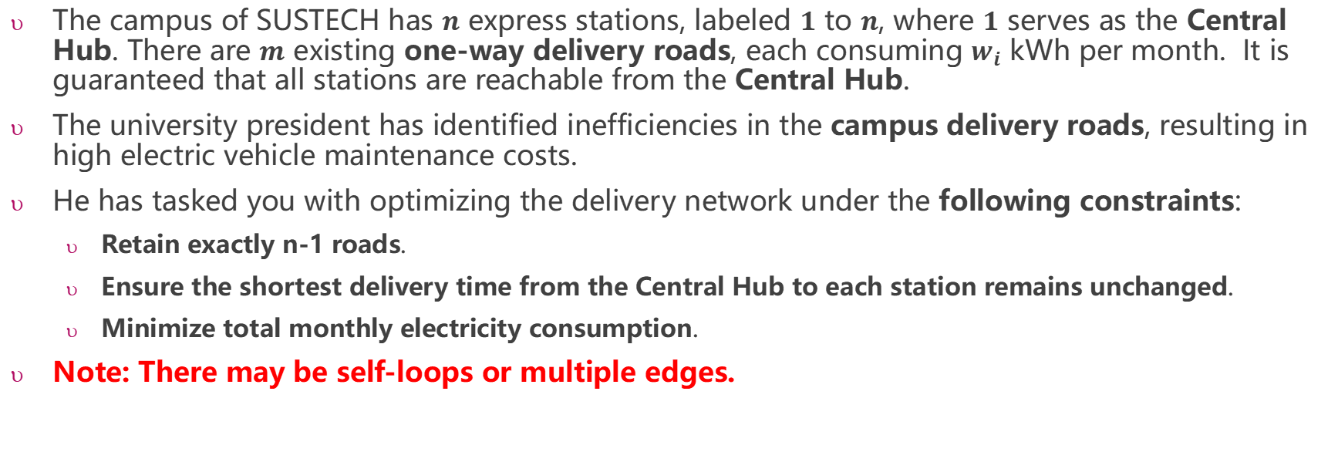
Lab4.B:Optimized Delivery Network for Campus Express Stations
The campus of SUSTECH has $n$ express stations, labeled $1$ to $n$, where $1$ serves as the Central Hub. There are $m$ existing one-way delivery roads, each consuming $w_{i}$ kWh per month. It is guaranteed that all stations are reachable from the Central Hub.
The university president has identified inefficiencies in the campus delivery roads, resulting in high electric vehicle maintenance costs.
He has tasked you with optimizing the delivery network under the following constraints:
Retain exactly n-1 roads.
Ensure the shortest delivery time from the Central Hub to each station remains unchanged.
Minimize total monthly electricity consumption.
Note: There may be self-loops or multiple edges.

Slide 16
Sample Input
5 10
1 2 5
2 3 6
1 4 4
3 5 4
3 4 5
1 5 5
1 2 5
2 3 6
3 4 6
4 5 4
5
6
5
6
1
5
2
6
3
1
2
3
5
5
5
4
4
4
6
4
5
4
5
4
Sample Output
20

Slide 17
Lab4.B: Solution
Sample Input
10
1
5
5 7
1 2 2
1 3 3
2 4 2
3 4 1
4 5 2
2 5 5
1 5 10
2
5
3
2
2
2
3
1
4

Slide 18
Lab4.B: Solution
Step1：Dijkstra's algorithm to find the shortest path from node 1
10
1
5
6
2
5
3
2
2
2
2
3
1
3
4
4

Slide 19
Lab4.B: Solution
Step2：how to choose n-1 edges to maintain the shotest distance and minimize the total cost?
For every node except node 1, each node must choose exactly one incoming edge. The selected incoming edge must lie on the shortest path from node 1 to that node, and its weight should be as small as possible.
10
Node | incoming edges | The selected edges
2 | (1,2) | (1,2)
3 | (1,3) | (1,3)
4 | (2,4) (3,4) | (3,4)
5 | (1,5) (4,5) (2,5) | (4,5)
1
5
6
2
5
3
2
2
2
2
3
1
3
4
4

